Slide 1



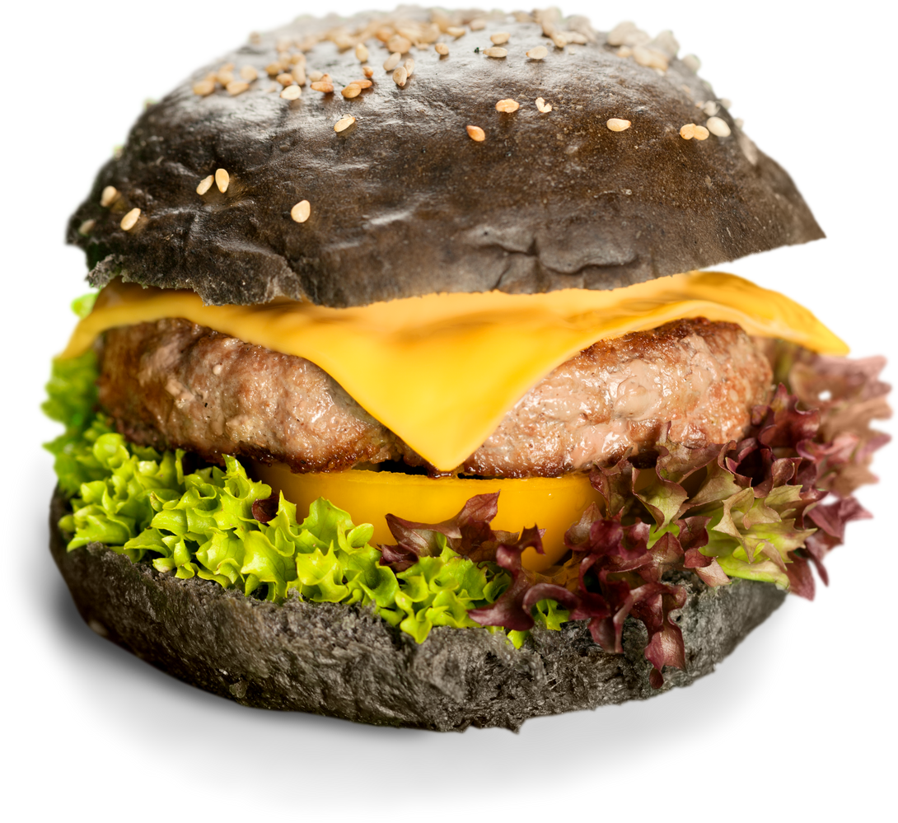

Unveiling Customer Insights:
A Deep Dive into McDonald's Reviews
Presentation - 2023
Yanhuan Huang
Yusen Tang
Jingwen He
Yvette Zhu
Yu Lu

Slide 2





Introduction
Our project goes into an large dataset containing over 33,000 anonymized reviews of McDonald's stores throughout the United States. This dataset represents a significant compilation of consumer feedback on one of the world's most recognizable fast-food chains. It includes a wide array of data points, including store names, categories, addresses, geographic coordinates, and, most importantly, customer reviews and ratings. By exploring these reviews, we aim to gain a detailed understanding of customer experiences and preferences, analyzing on what truly matters to consumers when they visit McDonald's. Our analysis seeks to bridge the gap between customer expectations and the current offerings, providing insights that could guide improvements in both product and service domains.

Slide 3


Objective
Our project is driven by a double perspective approach, focusing on both product-related insights and store-specific feedback to comprehensively understand customer focus points.
Identify Key Customer Concerns: Through advanced analysis techniques, we aim to pinpoint the primary areas of customer feedback related to McDonald's products and services, focusing on what customers value most.
Understand Variations Across Locations: By comparing customer sentiment across different stores, we seek to uncover the reasons behind varying levels of customer satisfaction, offering a clear picture of performance difference.
Leverage Data for Strategic Insights: Utilize data visualization, including an interactive map, to illustrate the geographic distribution of customer sentiments, enabling targeted improvements.
The expected outcome of our analysis is to provide McDonald's with strategic insights that can drive enhancements in customer satisfaction, potentially leading to increased loyalty, better store performance, and ultimately, greater business value.

Slide 4




Pre-Processing
Dropping Missing Rows and Values
Removal of stopwords
"and", "the", etc
Tokenization
Splits the text into words
Lemmatization
turning words back to their base form

Slide 5
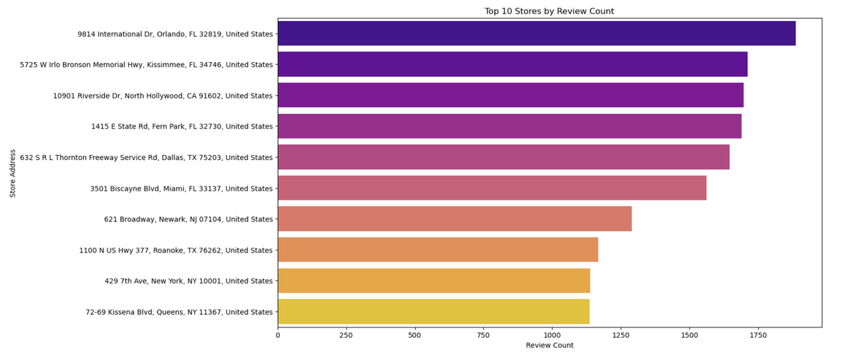
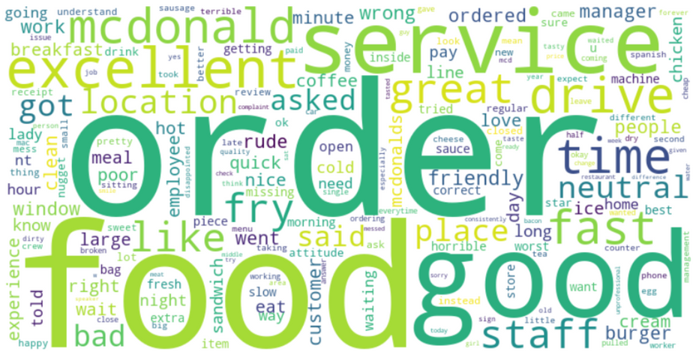
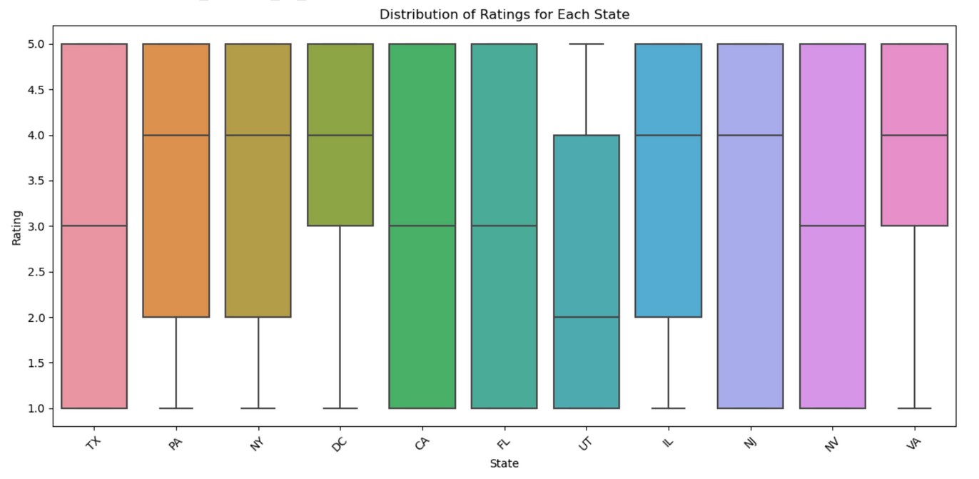
Explorary Data Analysis

Slide 6
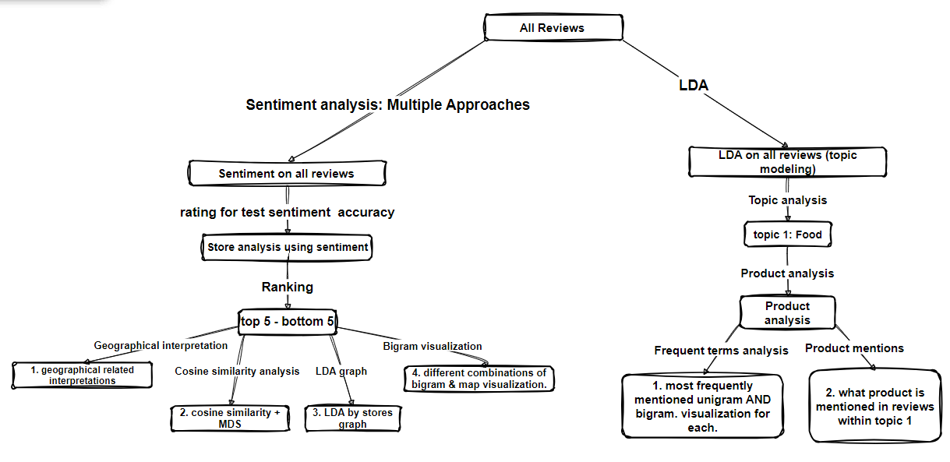

Slide 7
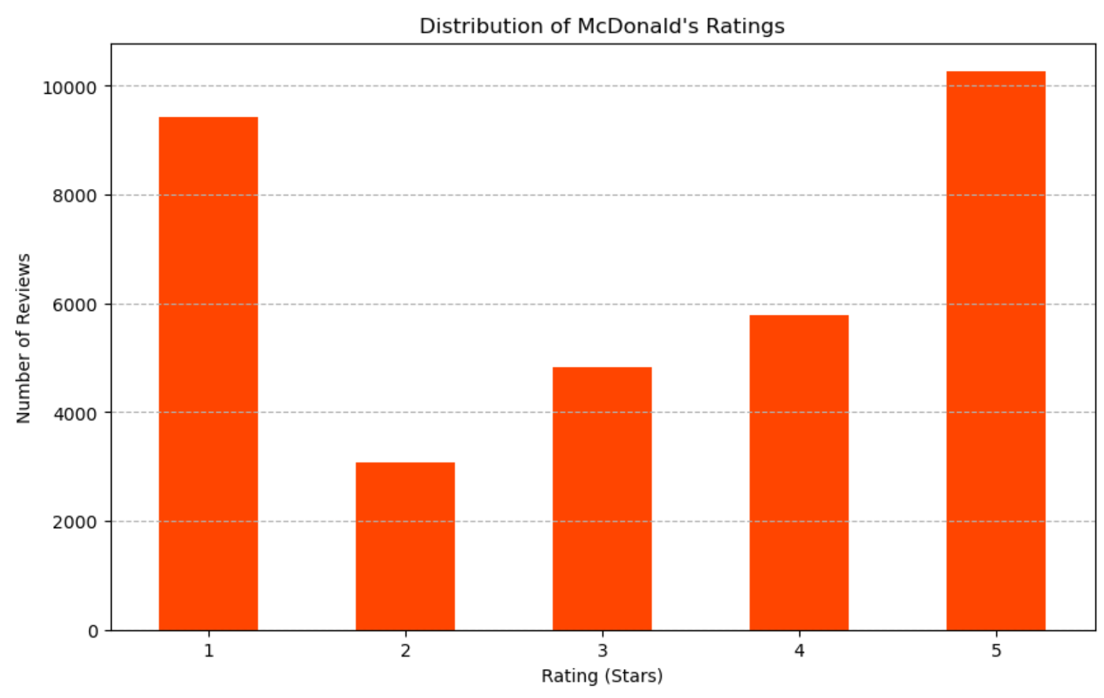
Data Preparation
The polarization of customer satisfaction - Most ratings are at the extreme (1 or 5).
We use customer ratings from our dataset to assess sentiment analysis accuracy by converting numeric ratings into "Positive", "Negative", or "Neutral" sentiments, based on the rating value, and adding these as a new column "rating_to_sent" to our dataset.
"Positive" for ratings above 3, "Negative" for ratings below 3, and "Neutral" for ratings exactly equal to 3.

Slide 8

1
Sentiment Analysis
Categorizing Reviews by Rating
Though spacy vader provides highest accuracy when doing sentiment analysis, NLTK works best while performing other following tasks, so we used NLTK in the end.
2
06
4
Best
Model
NLTK
Tokenization
+Vader
Approach:
NLTK Tokenization + VADER
SpaCy + VADER
ADJ/ADV POS + VADER
ADV POS + VADER
3 Evaluating Accuracy
NLTK：0.674
SpaCy：0.675

Slide 9
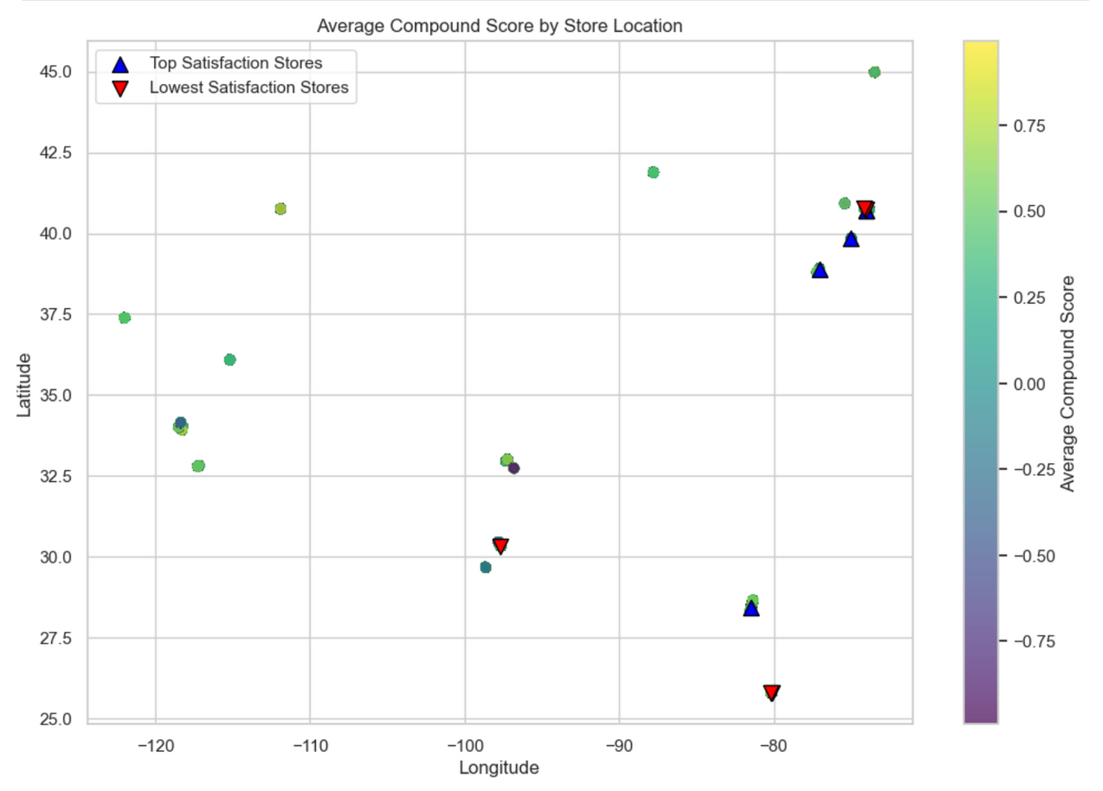
Store Analysis based on sentiments
Utilize customer review sentiment scores to analyze McDonald's store performance and customer satisfaction levels.
Identified top five stores with the highest satisfaction and bottom five with the lowest, revealing key areas for improvement and best practices.
Performance Benchmarking: The analysis sets a benchmark for store performance, enabling targeted improvements in underperforming locations.

Slide 10
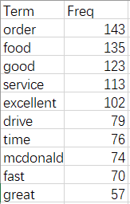
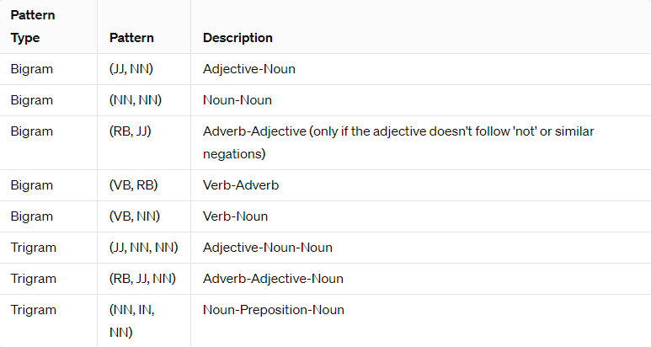
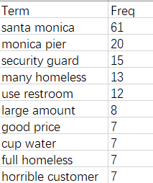
POS for better Customers’ Concern Understanding
Top Words Count for one Store
POS for Words Phrased Extraction
Rank rates and Sentiments Score

Slide 11
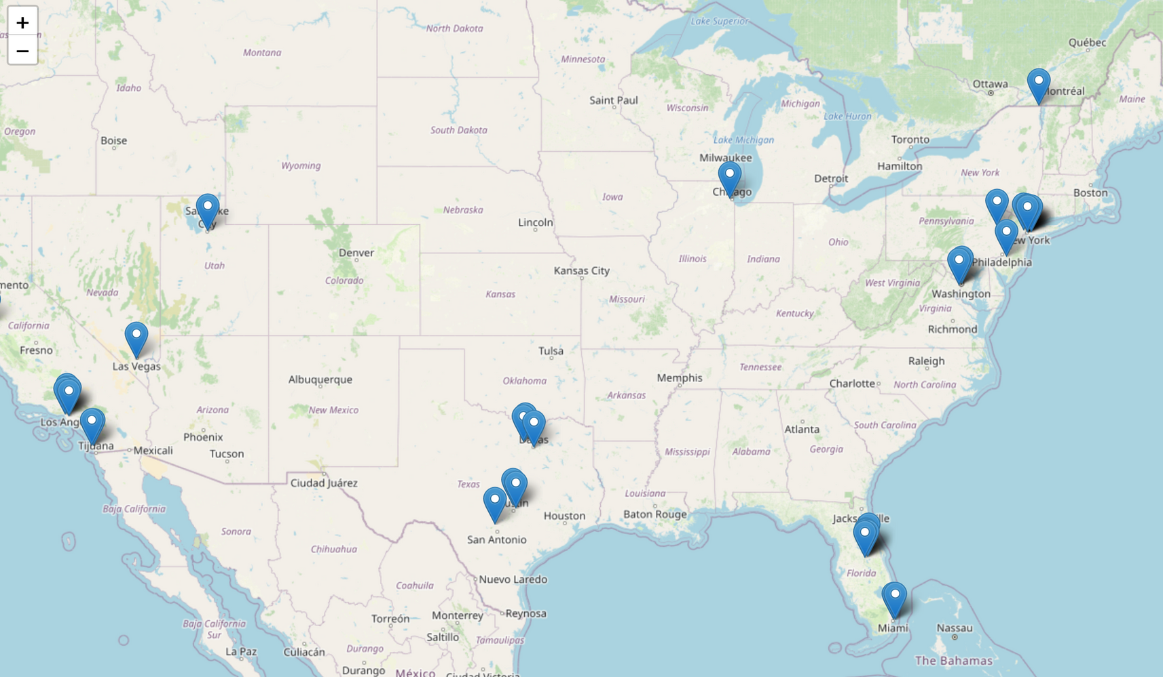
Store Analysis based on sentiments

Slide 12
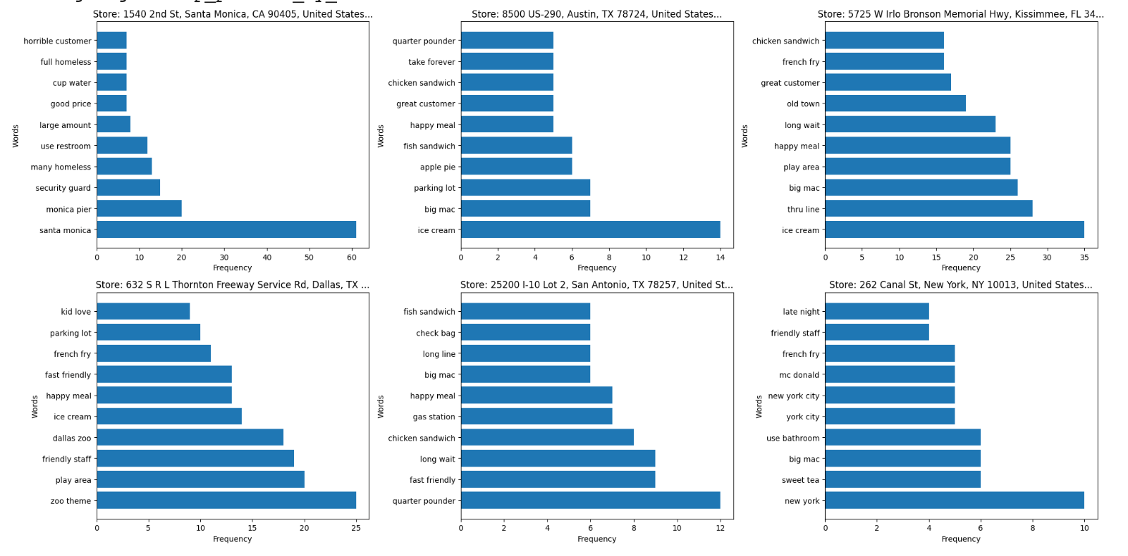
Store Analysis based on sentiments
By analyzing frequent phrases, McDonald's can gain detailed insights for each stores
into customer experiences and preferences, enabling targeted improvements in products and services.

Slide 13
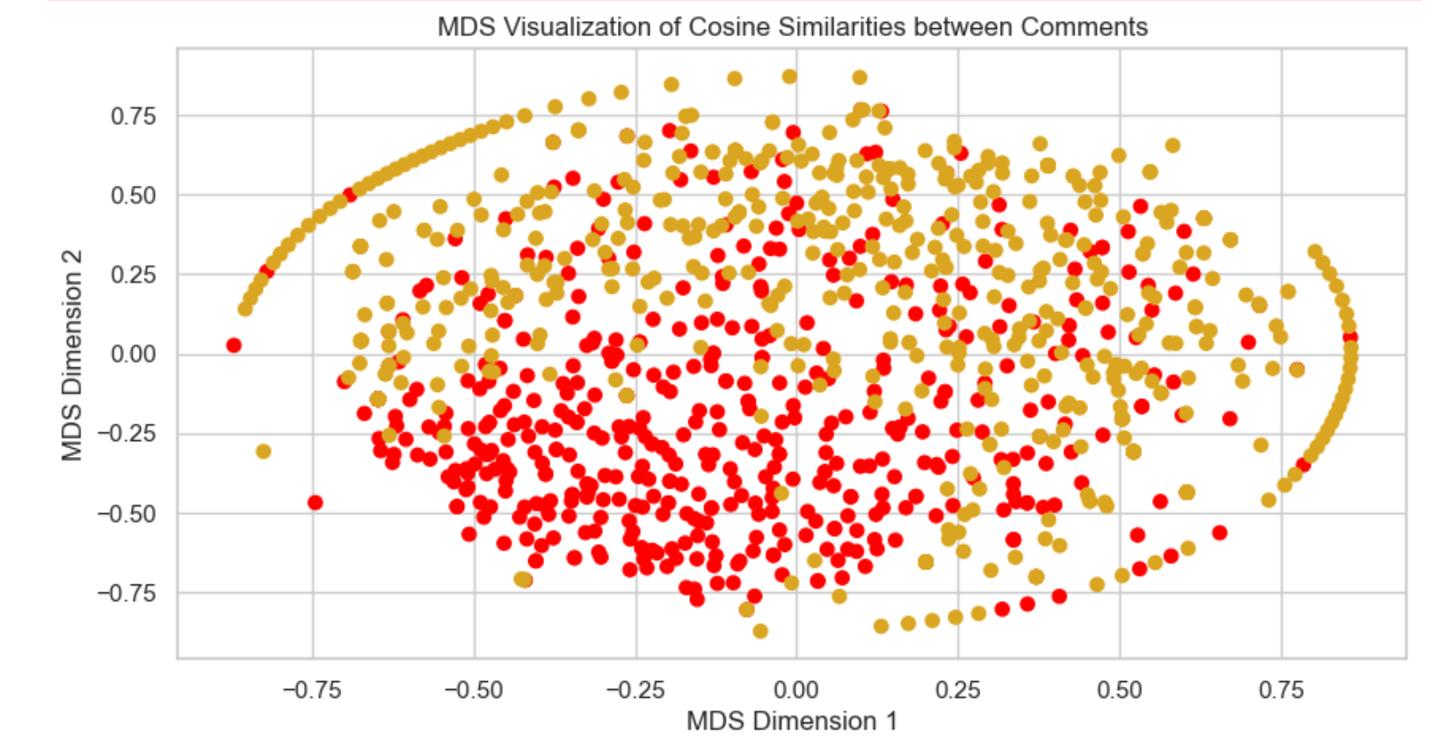
Store Analysis based on sentiments
We used utilized Multidimensional Scaling (MDS) to visualize cosine similarities between customer comments from top-performing and lowest-performing stores.
This visualization highlights the stark differences in customer sentiment, offering a clear visual representation of areas where customer experiences diverge significantly.

Slide 14
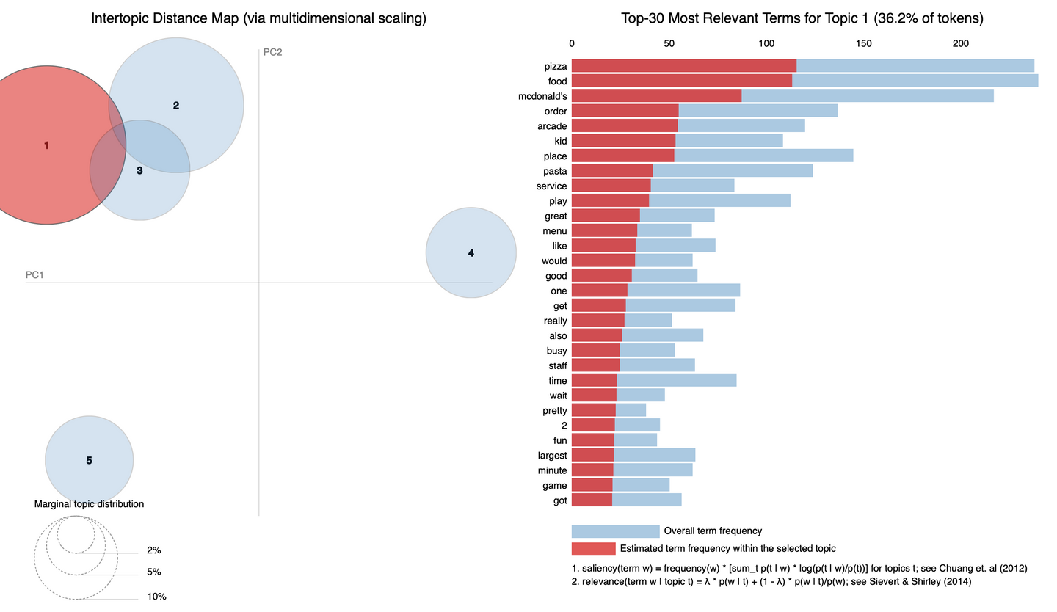
Interactive LDA Visualization for stores
Created an interactive LDA visualization based on reviews from the three top-rated stores.
Interactive LDA visualization provides insights into top rate store customer preferences and expectations, highlighting key factors driving satisfaction, thereby guiding strategic decisions to enhance overall customer experience at other stores.

Slide 15
Topic Modeling
Discover key themes in customer reviews using LDA with a focus on food-related comments.
Configured LDA to identify 5 distinct topics within the reviews.
Fitted the model on the DTM to uncover underlying topics.
Extracted the top 20 words from each topic to interpret customer sentiments and themes.
Selected Topic for Further Analysis (Topic 1): Focus on food-related comments for deeper insights.
Keywords: `large`, `asked`, `cheese`, `mcdonald`, `big`, `sauce`, `drink`, `nugget`, `time`, `sandwich`, `chicken`, `like`, `meal`, `cold`, `food`, `burger`, `got`, `ordered`, `order`, `fry`.
This analysis enables us to pinpoint areas for improvement in food offerings and customer service strategies.

Slide 16
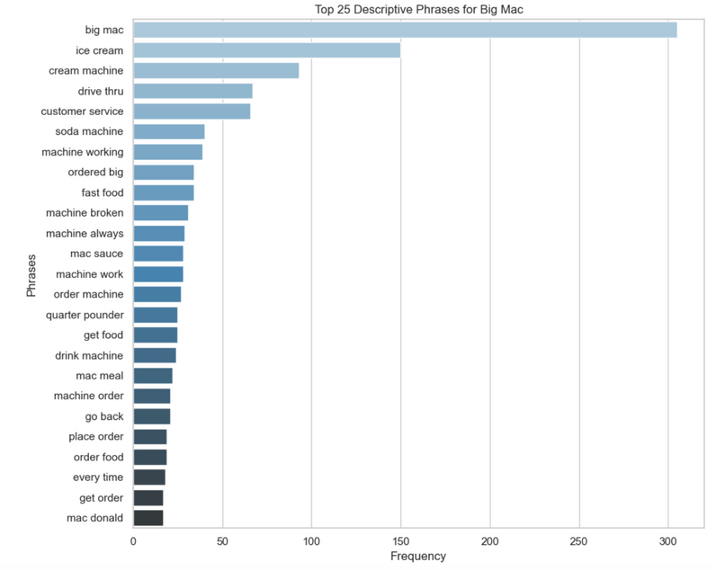
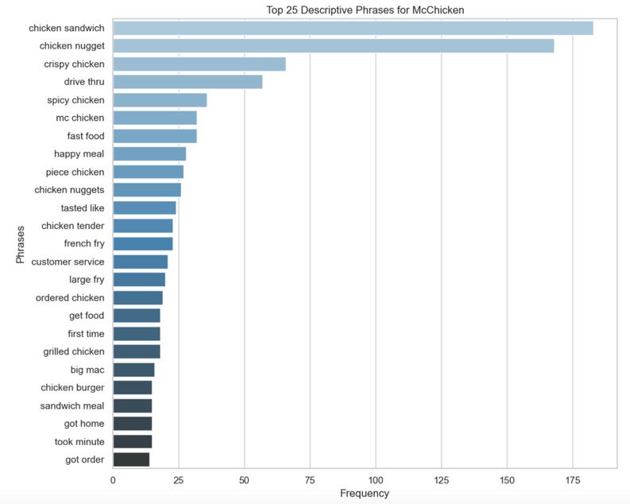
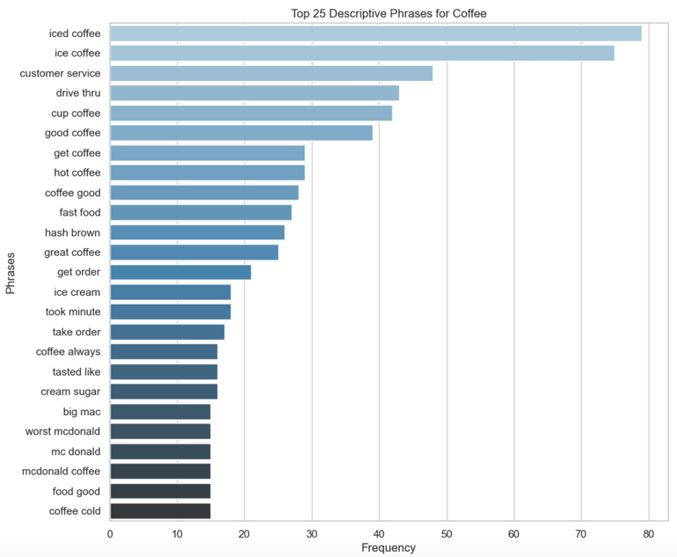
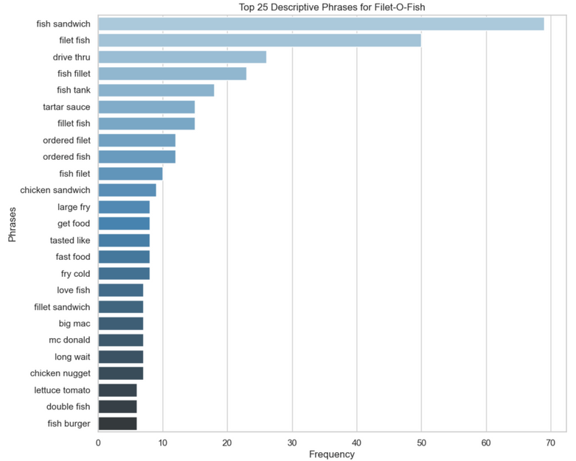
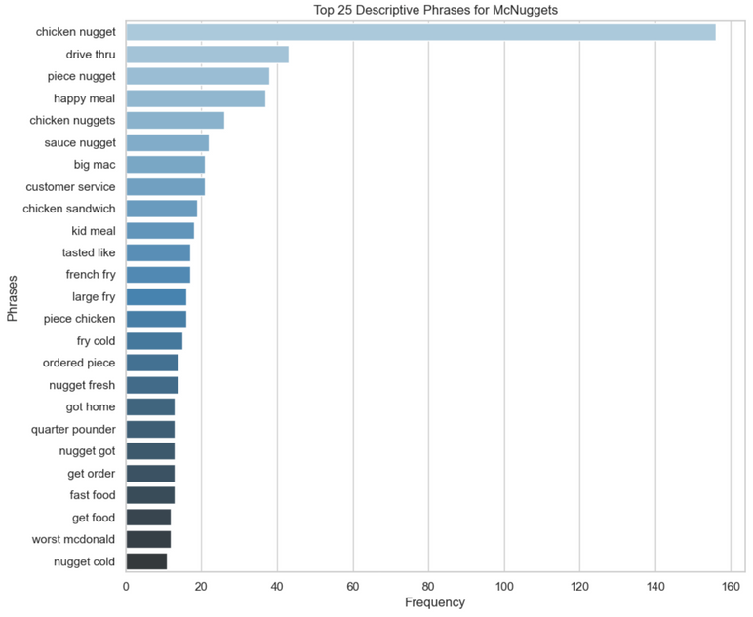
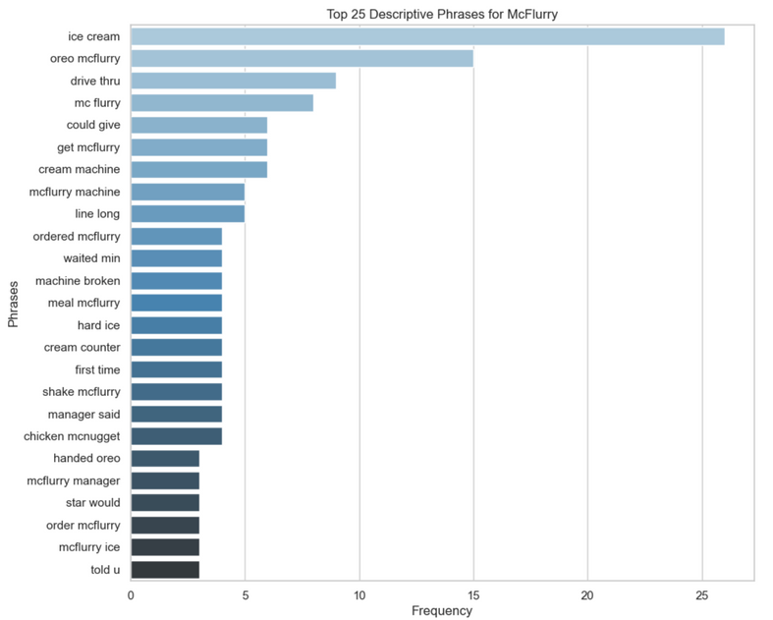
Product Analysis based on LDA results

Slide 17
Product Analysis based on LDA results
Product Focus: Identifying McDonald's products frequently mentioned alongside descriptive phrases in reviews highlights customer preferences and pain points.
Quality Insights: Frequent mentions of specific product attributes provide direct feedback on food quality and presentation.
Service Experience: Descriptive phrases related to service offer insights into customer service experiences, pinpointing areas for staff training and service improvements.
Menu Optimization: Analysis of descriptive phrases can guide menu adjustments by identifying popular items and those needing enhancement or promotion.
Operational Efficiency: Insights into specific products and associated customer feedback can drive operational improvements, from kitchen workflow adjustments to order accuracy initiatives.

Slide 18
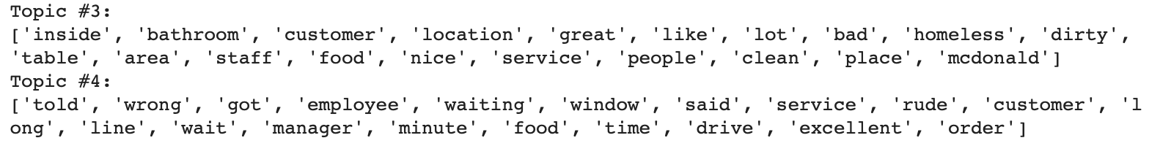
Future Steps
Deep Dive into other LDA Topics:
Topic 3 (Environment-related): Focus on cleanliness and environment. Prioritize store environment enhancements.
Topic 4 (Service -related): Analyze service-related feedback for targeted training and improvements.
Sentiment Analysis Optimization:
Apply Peter Turney’s algorithm to increase sentiment analysis accuracy, enabling finer discernment of customer emotions.
Database Expansion:
Enrich analysis with more reviews and social media feedback for comprehensive insights.
Dynamic Map Visualization Improvements:
Upgrade visualization tools for intuitive, real-time decision-making support for McDonald's leadership.

Slide 19
Impact on Business Strategy and Econimics
Business Strategy
Econimics
Customer Service Improvement:
Addressing common issues identified in reviews, like long wait times and staff interactions, can significantly enhance the customer experience.
Product Development:
Insights from topic analysis on food products guide R&D to refine existing offerings and innovate new items aligning with customer preferences.
Location Management:
Analysis of common words and sentiments associated with specific stores helps identify unique opportunities for each location, guiding investment and marketing strategies.
Customer Retention:
Improved service quality and tailored product offerings can boost customer loyalty, leading to repeat business and increased sales.
Operational Improvements:
Efficiency gains in order processing and staff training reduce operational costs and increase profitability.
Strategic Expansions:
Data-driven insights into location performance support strategic decisions on store renovations, openings, and closures, optimizing market presence.

Slide 20
Importance of Customer Feedback Analysis
-Guiding Innovation and Excellence
Informed Decision-Making:
Customer feedback analysis is crucial for adapting to changing consumer preferences and staying ahead in a competitive market.
Brand Reputation:
Proactively addressing feedback and improving service and product quality enhances McDonald's brand image and customer trust.
Sustainable Growth:
Insights from detailed feedback analysis support sustainable business growth, ensuring McDonald's remains a beloved brand for generations.

Slide 21


Thank You
For Watching

